Slide 1

Group 14:
Data Team
Revolutionize Claims Management:
Unleash the​ Power of GenAI for Peak Efficiency in the Insurance​ Sector​
Noorullah Khan | 47197404
Ninuri Mahagoda | 46592156
Tashiya Vilathgamuwa | 46992162
Quoc Hung Nguyen | 47578130
Aasnayem Chowdhury | 46325824

Slide 2




Agenda
Team Introduction
Value
Problem Statement
Demonstration
Solution
Reflection

Slide 3

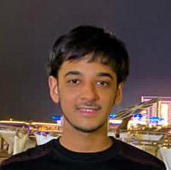
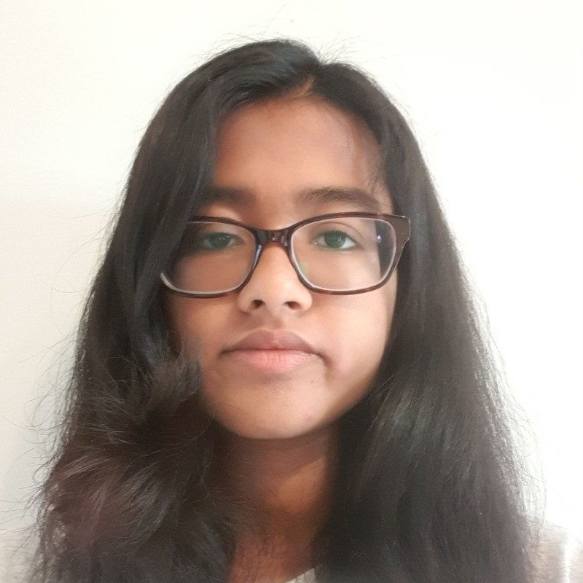
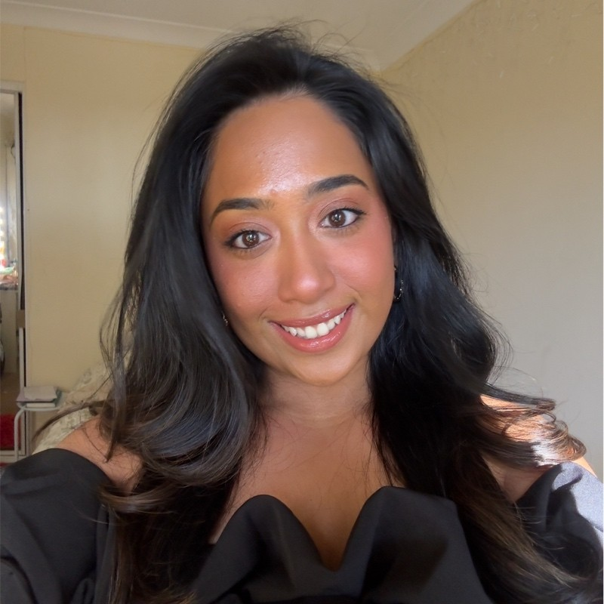


Noorullah Khan
Team Introduction
NRMA INSURANCE (CLIENT)
Data
Team
Aasnayem Chowdhury
Ninuri
Mahagoda
Tashiya Vilathgamuwa
Quoc
Nguyen
Noorullah
Khan
AI Team
Azure Solutions Architect
Project Manager / Lead Data & Software Engineer
Data Engineer & Data Modeller
Tech BA & Data Engineer
Tech BA & Data Engineer
TEAM 13

Slide 4




Ninuri Mahagoda
Problem Statement
PROBLEM
SOLUTION
PROJECT
OUR TASK
Lack of efficiency and accuracy resulting in increased operational costs and lengthy processing times
Current fraud detection process at NRMA needs to be simplified and uplifted through the use of GenAI
Split into Data Team and AI team and worked together to develop a end-to-end solution using GenAI
Create a high quality dataset of 20,000 rows that will be used by the AI team to train their GenAI model

Slide 5

Project Timeline
Noorullah Khan
July
November
 |  | Sprint 1 | Sprint 2 | Sprint 3 | Sprint 4 | Sprint 5 | Spring 6 | Sprint 7 | Sprint 8 | Sprint 9
Introduction | Introduction I
Begin Building | Begin Building I
 | Begin Building II
 | Finalise Building I
Cloud & UI Deployment | Finalise Building II
 | Deployment I
 | Deployment II
Testing & Final Product | Testing I
 | Finale I
Familiarise ourselves with the team, client and problem
Doing options analysis and create user stories
Sourcing, cleaning and enriching data
MVP 1
Synthesised and merged data
Began UI development
MVP 2
Model Training
AI Integration
TBD
Handover

Slide 6
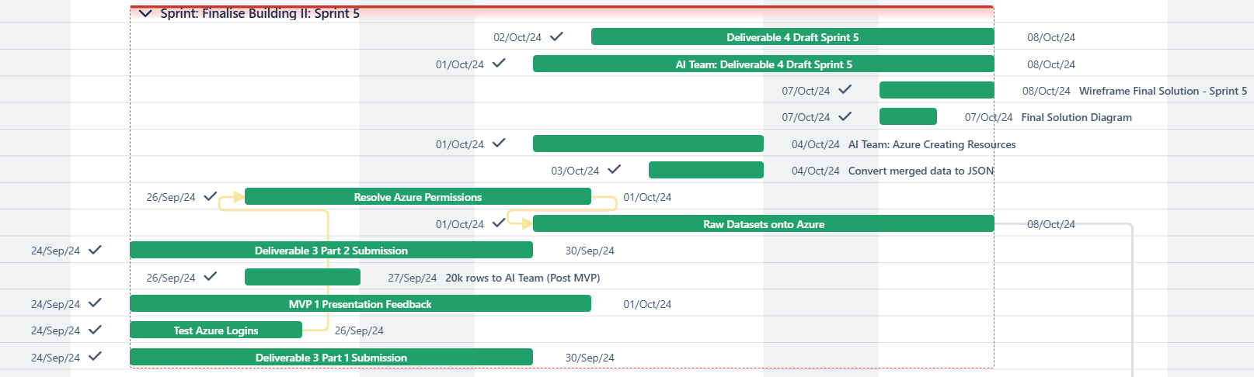
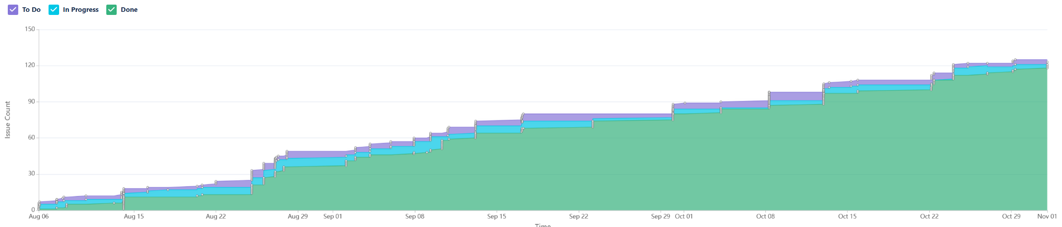
Noorullah Khan
Gantt Chart + Cumulative Flow Diagram
Used Atlassian’s Jira PM tool
Notes:
Intro
Sprint 1 introduction
Begin Building
Begin building Sprint 2,3
Finalise building sprint 4,5
Cloud and EY dlpoyement
Finalise building 2 sprint 5
Deployment sprint 6,7
Testing and final product
Testing sprint 8
Finale - sprint 9

Slide 7




Ninuri Mahagoda
Addressing the Problem
Kaggle Dataset Collection
Industry Research
nature of fraud detection systems and common fraudulent behaviors.
offers one of the largest, most reputable collections of publicly available datasets.
Finalised 3 key sources
User Stories
Identify Data Requirements
Perspective of the AI team and NRMA as the the client
Outline the specific needs of the users of the dataset
Removal of PII
Must contain a fraud label column

Slide 8
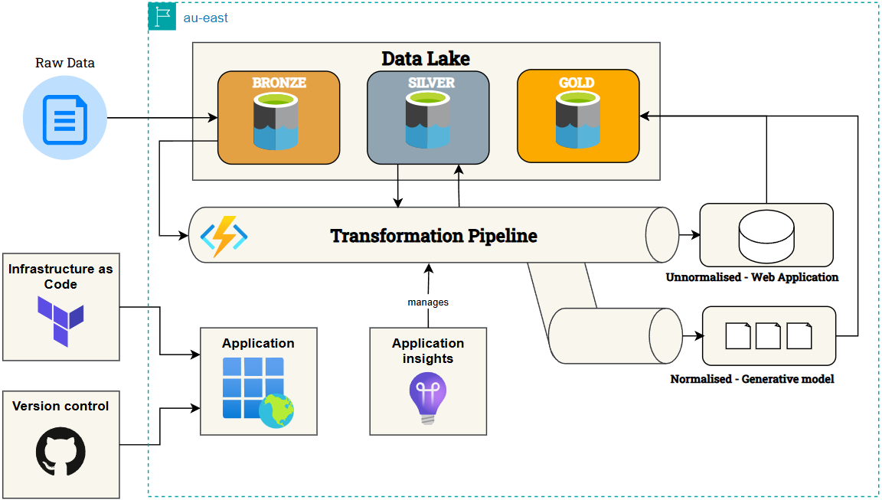
Quoc Hung Nguyen
Solution
Raw Data
Unnormalised Web Application
Manages
Normalised Generative Model
Notes:
How to get to the solution
pass onto the next person

Slide 9
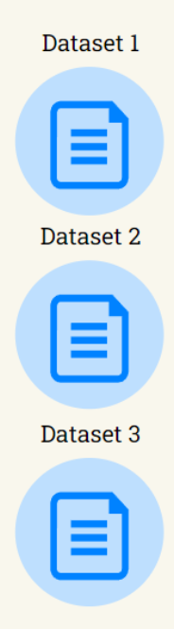
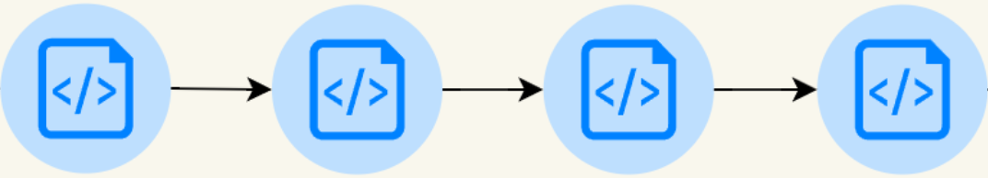

Aasnayem Chowdhury
Data Transformation Pipeline
RAW DATA
PROCESSED DATASET
CLEANING
ENRICHING
SYNTHESISING
MERGING
Missing values handled
Columns renamed using camelCase
Data Standardisation
Column creations
Unwanted columns dropped
Conversion of categorical columns to numeric
Two synthesisation methods used
1.Remapping and Random Sampling
2. CTGAN (Generative Adversarial Network)
3 Raw datasets and 2 synthesised datasets merged
Contains an index and a fraud column
Dataset consists of 20,877 rows

Slide 10
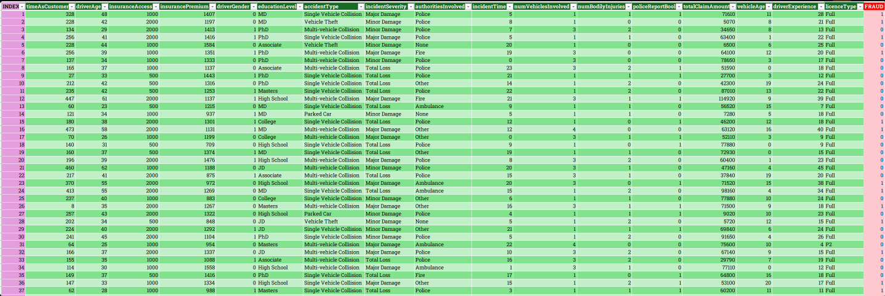
Aasnayem Chowdhury
Final Dataset

Slide 11
01 Business Value
Tashiya Vilathgamuwa
Cost Savings: Reduces losses from fraud, saving millions
Reputation Boost: Enhances NRMA’s position as a tech leader
Value
02 Competitive Edge
Innovation: leading the way in AI based fraud detection
Market Differentiation: Attracts clients seeking transparency
03 Empowering Claims Officers
Satisfaction: Reduces repetitive work, provides insights → enables quickers decision making.
Efficiency: AI automates screening, allowing focus on complex cases
04 Customer Experience
Quick Resolutions: With the AI model = Fast, fair claims processing builds loyalty
Loyalty: Satisfied customers promote positive word-of-mouth = enhances NRMA’s brand reputation

Slide 12
Live Demonstration
YouTube
Noorullah Khan
Secure Login
Claim Management Tool
Restricted access for authorized agents only.
Add notes, update claim outcomes, and close cases seamlessly.
Dashboard Overview
User Friendly Interface
Quick view of pending and completed claims.
Simple layout with intuitive feedback and interface.
AI-Powered Fraud Detection
History & Insights
Real-time fraud risk scoring and analysis.
"Explain More" feature for detailed insights.
Ask AI feature to ask specific questions
Page to view log of all processed cases and their notes + outcomes.

Slide 13
Ninuri Mahagoda
Reflection
Built High Quality Dataset
03
04
Power BI
02
05
Collaboration
Integrate System
01
06
Overcoming Challenges
Develop Front-End Design

Slide 14
THANK YOU FOR LISTENING!

Slide 15
Noorullah Khan
Project Timeline
July
November
 |  | Sprint 1 | Sprint 2 | Sprint 3 | Sprint 4 | Sprint 5 | Sprint 6 | Sprint 7 | Sprint 8
Introduction | Introduction
Begin Building | Begin Building
 | Finalise Building I
Cloud and UI Deployment | Finalise Building II
 | Deployment
Testing & Final Product | Testing
 | Finale
Notes:
Intro
Sprint 1 introduction
Begin Building
Begin building Sprint 2,3
Finalise building sprint 4,5
Cloud and UI deployment
Finalise building 2 sprint 5
Deployment sprint 6,7
Testing and final product
Testing sprint 8
Finale - sprint 9

